Slide 1

Hadoop
Cloudera
Trainer:- Deep Pandey

Slide 2
ETL on Hadoop

Slide 3
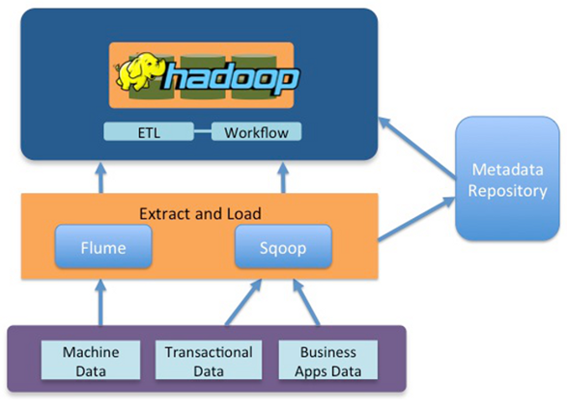
ETL on Hadoop
Steps to setup Hadoop for ETL:
Set up a Hadoop cluster,
Connect data sources,
Define the metadata,
Create the ETL jobs,
Create the workflow.

Slide 4
PIG

Slide 5
PIG
Open source High Level Dataflow system for data stored in HDFS. It provides a simple language for queries and data manipulation.
PIG Background
Ease for developers.
Developed by Yahoo Research Team.
Work on any kind of data
Subset of Map Reduce
Base of Major programs at Yahoo

Slide 6
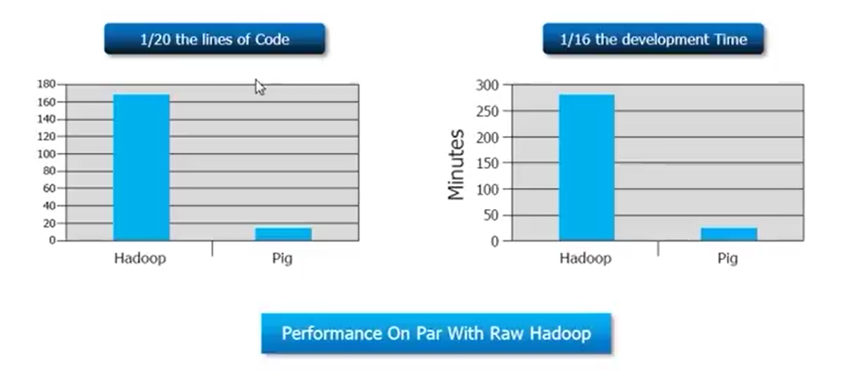

Slide 7
Comparative Analysis

Slide 8
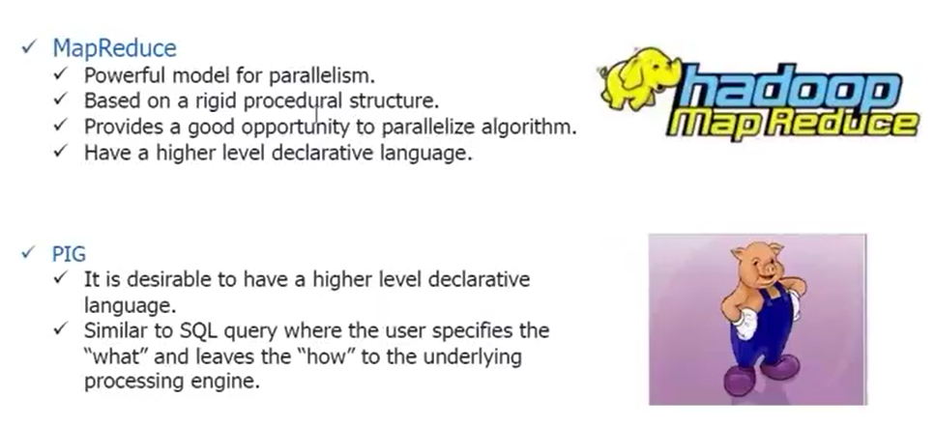
Why PIG ?

Slide 9
Use Cases where PIG is Used
Processing of weblogs
Data processing for search platforms
Support for Ad Hoc queries across large data sets
Quick prototyping of algorithms for processing large datasets,

Slide 10
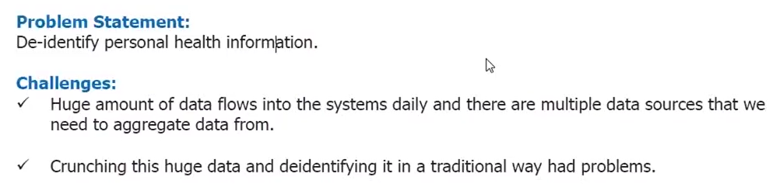
Use Case in Health Care

Slide 11
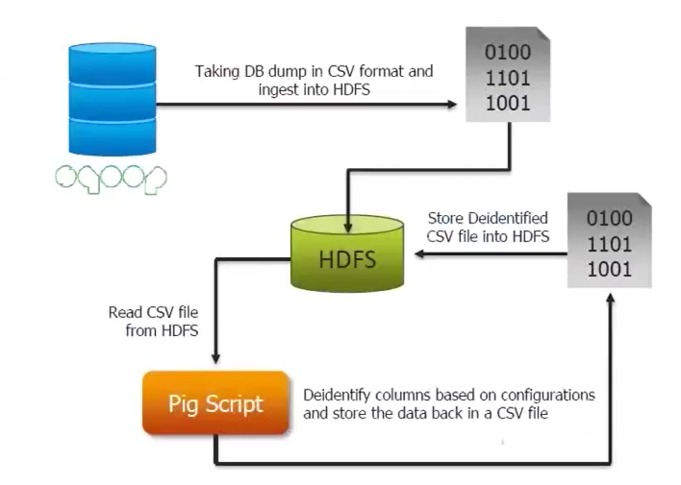

Slide 12
PIG Components
PIG Latin
PIG Execution Engine

Slide 13
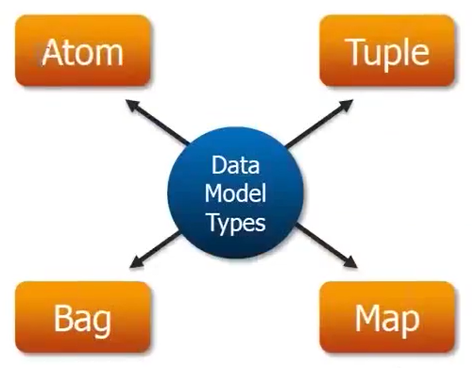
PIG Data Models
ATOM:- Individual Value
TUPLE:- Brackets which contain some ordered list of values
BAG:- Collection of ordered values
MAP:- Key Value Pair

Slide 14
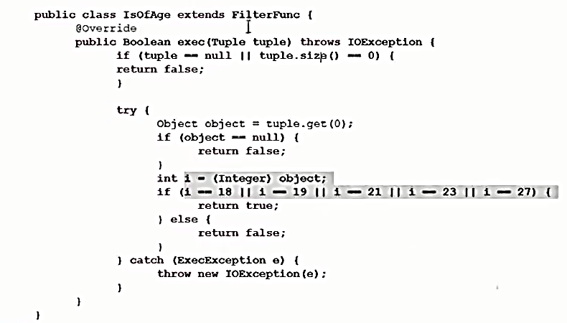
Program to create UDF

Slide 15
HBASE

Slide 16
NoSQL
Often interpreted as Not Only SQL
Provides a mechanism for storage and retrieval of data.
Simplicity of design, horizontal scalability and finer control over ability
NoSQL databases are generally used in Big Data and Real Time web applications
Column
Cassandra, HBase, Druid, Accumulo, Vertica
Document
Lotus Notes, Clusterpoint, Apache CouchDB, CouchBase, MarkLogic, MongoDB, OrientDB, Qizx
Key-Value
CouchDB, Dynamo, FoundationDB, MemcacheDB, Redis, Riak, Faircom, c-tree ACE, Aerospike, OrientDB, MUMPS
Graph
Allegro, Neo4j, Infinite Graph, OrientDB, Virtuoso, Stardog

Slide 17
CAP - THEOREM
The theorem states that within a large-scale distributed data system, there are three requirements that have a relationship of sliding dependency: Consistency, Availability, and Partition Tolerance.
Consistency :- All database clients will read the same value for the same query, even given concurrent updates.
Availability :- All database clients will always be able to read and write data.
Partition Tolerance :- The database can be split into multiple machines; it can continue functioning in the face of network segmentation breaks.
Brewer’s theorem is that in any given system, you can strongly support only two of the three.

Slide 18
Performance Analysis
Data Model | Performance | Scalability | Flexibility | Complexity | Functionality
Key–Value Store | high | high | high | none | variable (none)
Column-Oriented Store | high | high | moderate | low | minimal
Document-Oriented Store | high | variable (high) | high | low | variable (low)
Graph Database | variable | variable | high | high | graph theory
Relational Database | variable | variable | low | moderate | relational algebra

Slide 19
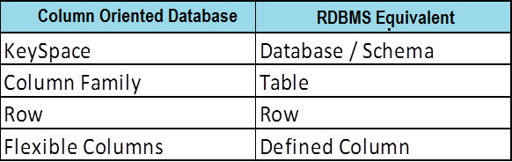
HBase
Column Oriented Database
Hadoop Application
Linear scalable
Non relational

Slide 20
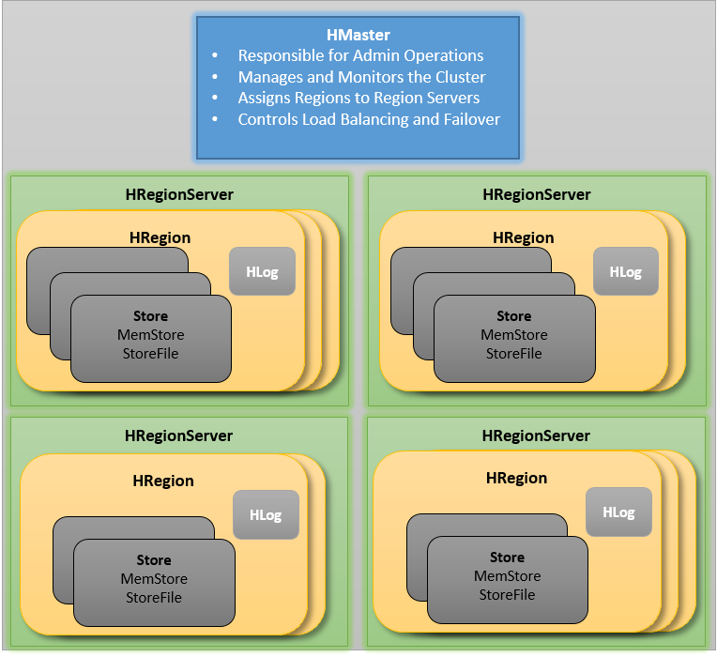
HBase Architecture & Data Model
Responsibilities of HMaster
Performing Administration
Managing and Monitoring the Cluster
Assigning Regions to the Region Servers
Controlling the Load Balancing and Failover
Responsibilities of HRegionServer
Hosting and managing Regions
Splitting the Regions automatically
Handling the read/write requests
Communicating with the Clients directly

Slide 21
Tables – The HBase Tables are more like logical collection of rows stored in separate partitions called Regions. As shown above, every Region is then served by exactly one Region Server. The figure above shows a representation of a Table.
Rows – A row is one instance of data in a table and is identified by a rowkey. Rowkeys are unique in a Table and are always treated as a byte[].
Column Families – Data in a row are grouped together as Column Families. Each Column Family has one more Columns and these Columns in a family are stored together in a low level storage file known as HFile. Column Families form the basic unit of physical storage to which certain HBase features like compression are applied. Hence it’s important that proper care be taken when designing Column Families in table. The table above shows Customer and Sales Column Families. The Customer Column Family is made up 2 columns – Name and City, whereas the Sales Column Families is made up to 2 columns – Product and Amount.
Columns – A Column Family is made of one or more columns. A Column is identified by a Column Qualifier that consists of the Column Family name concatenated with the Column name using a colon – example: columnfamily:columnname. There can be multiple Columns within a Column Family and Rows within a table can have varied number of Columns.
Cell – A Cell stores data and is essentially a unique combination of rowkey, Column Family and the Column (Column Qualifier). The data stored in a Cell is called its value and the data type is always treated as byte[].

Slide 22
HBase Do’s
If your application has a variable schema where each row is slightly different.
When you can’t add columns fast enough and most of them are NULL in each row.
If you find that your data is stored in collections, for example some meta data, message data or binary data that is all keyed on the same value.
If you need key based access to data when storing or retrieving.
Don’t expect to use HBase as a wholesale replacement for every one of your relational databases.
HBase is CPU and Memory intensive, So keep an eye on memory and CPU Usage
HBase Don’t

Slide 23
Lunch Break

Slide 24
HIVE

Slide 25
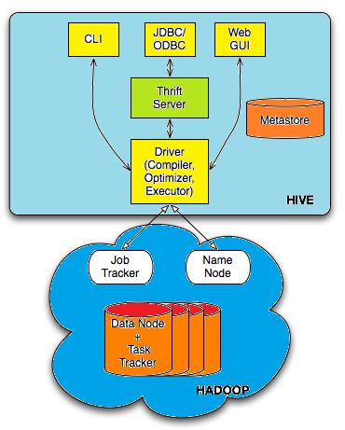
Hive

Slide 26
HIVE DATA MODEL
Table
Partitions
Buckets

Slide 27
STEPS OF PARTITIONING
Load data file into non partitioned table
Load Non Partitioned table data to partitioned table
SYNTAX OF PARTITIONING
CREATE TABLE <table_name> (COLUMN datatypes)
PARTITIONED BY (COLUMN datatypes);
INSERT INTO <table_name>
PARTITION (COLUMN = <values>)
SELECT COLUMNS
FROM <source_table>
WHERE <PARTITION COLUMNS = <values>>;

Slide 28
AUTOMATIC PARTITIONING
SET hive.exec.dynamic.partition = true;
SET hive.exec.dynamic.partition.mode = nonstrict;
INSERT INTO <table_name>
PARTITION (COLUMN)
SELECT COLUMNS
FROM <source_table>
WHERE <PARTITION COLUMN = <value>>;

Slide 29
BUCKETING
CREATE TABLE <table_name>
(COLUMNS datatypes)
CLUSTERED BY (column) INTO n BUCKETS;
DATA LOADING IS SAME AS IN PARTITIONING
SET hive.enforce.bucketing = true;

Slide 30
MANAGED TABLES
Managed by default by Hive.
Hive moves the data to its warehouse directory.
On dropping, table along with its metadata and its data is deleted
EXTERNAL TABLES
Data stored outside the warehouse directory
Can store data lazily
On dropping, data remains outside of warehouse directory

Slide 31
SQOOP

Slide 32
Sqoop
Primary objective of Apache Sqoop is to Import and Export data to and from RDBMS and Hadoop.
TOOLS
IMPORT:- Imports individual tables from RDBMS
IMPORT-ALL-TABLE:- Imports all tables in RDBMS
EXPORT:- This exports data from HDFS to RDBMS
EVAL:- Evaluating the SQL Language query using sqoop tool
OPTIONS-FILE:- Allows to write sqoop script in an external file and can be used dynamically.

Slide 33
Tea Break

Slide 34
FLUME & CHUKWA

Slide 35
Flume
CLIENT
SINK 1
SINK
SOURCE
CHANNEL
SINK 2
CHANNEL 2
AGENT

Slide 36
Chukwa
HDFS
M/R jobs
DATA SINK
DATA
App1 log
App2 log
Appn log
AGENTS
COLLECTOR

Slide 37
